Slide 1
SOFTWARE REENGINEERING
1

Slide 2
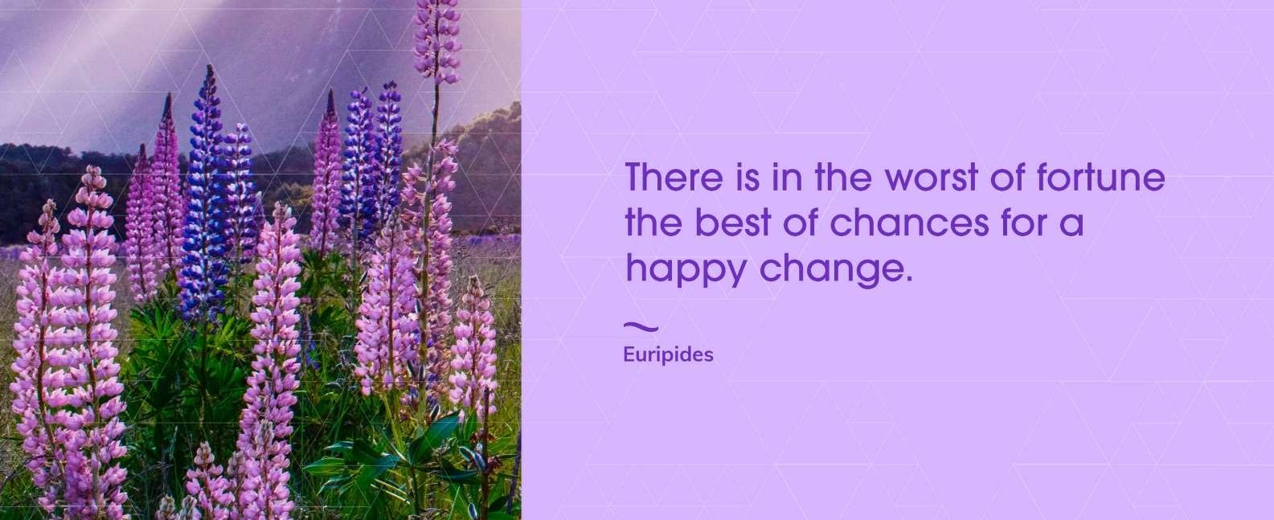
Today’s Quote
2

Slide 3
Code Refactoring
3
Definition
Motivation
Code Smells

Slide 4
Where are we?
Over the semester we have talked about Software ReEngineering.
The overall goal of software reengineering is to...
There are always pressures and reasons that software isn’t great
Coming up: Why do good developers write bad software?

Slide 5
Reengineering and Refactoring?
5

Slide 6
Why do good developers write bad software?
Requirements change over time, making it hard to update your code (leading to less optimal designs)
Time and money cause you to take shortcuts
You learn a better way to do something (the second time you paint a room, it’s always better than the first because you learned during the first time!)
Two questions:
How do we fix our software?
How do we know our software is “bad”… when it works fine!
Coming up: Refactoring

Slide 7
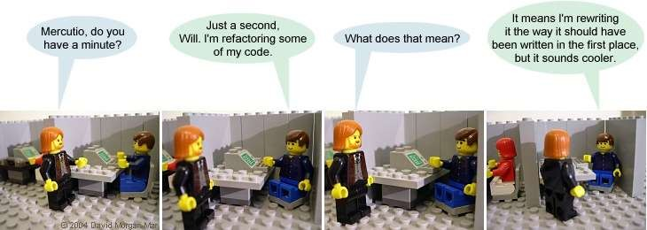
Refactoring
Definition: Refactoring modifies software to improve its readability, maintainability, and extensibility without changing what it actually does.
External behavior does NOT change
Internal structure is improved
Coming up: Refactoring

Slide 8
Refactoring
The goal of refactoring is NOT to add new functionality
The goal of refactoring is to make code easier to maintain in the future
Coming up: Refactoring Simple Example

Slide 9



Refactoring Simple Example
Move a method:
Motivation: A method is, or will be, using or used by more features of another class than the class on which it is defined.
Technique: Create a new method with a similar body in the class it uses most. Either turn the old method into a simple delegation, or remove it altogether.
Coming up: Danger!

Slide 10
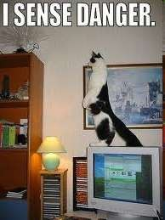
Danger!
Refactoring CAN introduce problems, because anytime you modify software you may introduce bugs!
Management thus says:
Refactoring adds risk!
It’s expensive – we’re spending time in development, but not “seeing” any
external differences? And we still have to retest?
Why are we doing this?
Coming up: Motivation

Slide 11
Motivation
We refactor because we understand getting the design right the first time is hard and you get many benefits from refactoring:
Code size is often reduced
Confusing code is restructured into simpler code
Both of these greatly improve mainatainability! Which is required because requirements always change!
Coming up: Refactoring: Complex Example

Slide 12
Refactoring: Complex Example
Introduce Null Object
Motivation: You have many checks for null
Technique: Replace the null value with a null object.
Customer c = findCustomer(...);
...
if (customer == null) {
name = “occupant”
} else {
name = customer.getName()
}
if (customer == null) {
…
Coming up: Refactoring: Complex Example

Slide 13
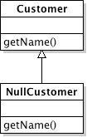
Refactoring: Complex Example
public class NullCustomer extends Customer {
public String getName() { return “occupant”
}
------------------------------------------------------------
Customer c = findCustomer() name = c.getName()
Completely eliminated the if statement by replacing checks for null with a null object that does the right thing for “null” values.
Coming up: Refactoring Example: Replace Conditional with Polymorphism

Slide 14
Refactoring Example: Replace Conditional with Polymorphism
Motivation: You have a conditional that chooses different behavior depending on the type of an object.
Technique: Move each leg of the conditional to an overriding method in a subclass. Make the original method abstract.
double getSpeed() { switch (_type) { case EUROPEAN:
return getBaseSpeed(); case AFRICAN:
return getBaseSpeed() - getLoadFactor() * _numberOfCoconuts; case NORWEGIAN_BLUE:
return (_isNailed) ? 0 : getBaseSpeed(_voltage);
} throw new RuntimeException ("Should be unreachable");
}
Coming up: Refactoring Example: Replace Conditional with Polymorphism

Slide 15
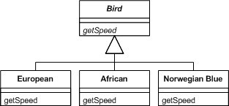
Refactoring Example: Replace Conditional with Polymorphism
Coming up: When do I refactor?

Slide 16

When do Refactor?
When you add functionality
Before you add new features, make sure your design and current code is “good” this will help the new code be easier to write
When you need to fix a bug
When you do a peer review
Coming up: How do I identify code to refactor?

Slide 17

How do identify code to refactor?
Martin Fowler uses “code smells” to identify when to refactor.
Code smells are bad things done in code, somewhat like bad patterns in code
Many people have tied code smells to the specific refactorings to fix the smell
Coming up: Code Smells

Slide 18
Code Smells
Duplicated Code
bad because if you modify one instance of duplicated code but not the others, you (may) have introduced a bug!
Long Method
long methods are more difﬁcult to understand
performance concerns with respect to lots of short methods are largely obsolete
Coming up: Code Smells

Slide 19
Code Smells
Large Class
classes try to do too much, which reduces cohesion
Long Parameter List
hard to understand, can become inconsistent
Divergent Change
Related to cohesion: symptom: one type of change requires changing one subset of methods; another type of change requires changing another subset
Coming up: Code Smells

Slide 20
Code Smells
Lazy Class
A class that no longer “pays its way”
e.g. may be a class that was downsized by a previous refactoring, or represented planned functionality that did not pan out
Speculative Generality
“Oh I think we need the ability to do this kind of thing someday”
Temporary Field
An attribute of an object is only set in certain circumstances; but an object should need all of its attributes
Coming up: Code Smells

Slide 21
Code Smells
Data Class
These are classes that have ﬁelds, getting and setting methods for the ﬁelds, and nothing else; they are data holders, but objects should be about data AND behavior
Refused Request
A subclass ignores most of the functionality provided by its superclass
Subclass may not pass the “IS-A” test
Comments (!)
Comments are sometimes used to hide bad code
“…comments often are used as a deodorant” (!)
Coming up: Many more code smells

Slide 22
SMELLS EXAMPLE – See which smells you find in the sample code Duplicated Code
Long Method Large Class
Long Parameter List
Divergent Change- Related to cohesion: symptom: one type of change requires changing one subset of methods; another type of change requires changing another subset
Data Class - These are classes that have ﬁelds, getting and setting methods for the ﬁelds, and nothing else; they are data holders, but objects should be about data AND behavior
Refused Request - A subclass ignores most of the functionality provided by its superclass
Comments (!) - Comments are sometimes used to hide bad code
Lazy Class - A class that no longer “pays its way”
Speculative Generality - “Oh I think we need the ability to do this kind of thing someday”
Temporary Field - An attribute of an object is only set in certain circumstances; but an object should need all of its attributes

Slide 23
Why use them?
Code smells and refactoring are techniques to help you discover problems in design and implementation and apply known solutions to these problems
Should they be used all the time? You should always think about them, but only apply them when they make sense… sometimes you need a long method… but think about it to make sure!
Coming up: Adding safety

Slide 24
Adding safety
Remember that making these changes invites some risk of introducing bugs!
To reduce that risk
You must test constantly – using automated tests wherever possible
Use refactoring patterns – I’ve shown you two… there are more.. many more!
http://www.refactoring.com/catalog/index.html
Use tools! Netbeans and Eclipse both support basic refactoring (http://wiki.netbeans.org/Refactoring)
Coming up: Question from your boss

Slide 25
Superclass refactoring
Superclass refactoring is an object-oriented programming technique where you extract common behaviour or attributes from multiple classes and move them into a shared superclass to promote code reuse and reduce duplication.
When to Use
Two or more classes have duplicate fields, methods, or logic.
You want to follow the DRY (Don't Repeat Yourself) principle.
There’s an opportunity to introduce polymorphism.

Slide 26
Before
class Dog {
void eat() {
System.out.println("Dog is eating");
}
void sleep() {
System.out.println("Dog is sleeping");
}
}
class Cat {
void eat() {
System.out.println("Cat is eating");
}
void sleep() {
System.out.println("Cat is sleeping");
}
}

Slide 27
After
class Animal {
void eat() {
System.out.println("Animal is eating");
}
void sleep() {
System.out.println("Animal is sleeping");
}
}
class Dog extends Animal {
// Additional Dog-specific methods can be added here
}
class Cat extends Animal {
// Additional Cat-specific methods can be added here
}
public class Main {
public static void main(String[] args) {
Animal dog = new Dog();
Animal cat = new Cat();
dog.eat(); // Animal is eating
cat.sleep(); // Animal is sleeping
}
}

Slide 28
Extract Method refactoring
Extract Method refactoring is a technique where you take a piece of code from a method and move it into its own new method. This helps improve readability, reuse, and maintainability.
Before:
public class InvoicePrinter {
public void printInvoice() {
System.out.println("Invoice:");
System.out.println("Customer: John Doe");
System.out.println("Item: Book");
System.out.println("Price: $10");
System.out.println("Thank you for your purchase!");
}
}

Slide 29
After
public class InvoicePrinter {
public void printInvoice() {
printHeader();
printDetails();
printFooter();
}
private void printHeader() {
System.out.println("Invoice:");
}
private void printDetails() {
System.out.println("Customer: John Doe");
System.out.println("Item: Book");
System.out.println("Price: $10");
}
private void printFooter() {
System.out.println("Thank you for your purchase!");
}
}

Slide 30
Pull-up method is a refactoring
Pull-up method is a refactoring technique where you move identical methods from subclasses to a common superclass to eliminate duplication.
Before refactoring:
class Animal {
// Superclass with no speak() method yet
}
class Dog extends Animal {
public void speak() {
System.out.println("Bark");
}
}
class Cat extends Animal {
public void speak() {
System.out.println("Meow");
}
}

Slide 31
Before Pull-Up (Duplicated Method)
class Dog extends Animal {
public void eat() {
System.out.println("Eating food");
}
}
class Cat extends Animal {
public void eat() {
System.out.println("Eating food");
}
}

Slide 32
After Pull-Up Refactoring
class Animal {
public void eat() {
System.out.println("Eating food");
}
}
class Dog extends Animal {
// No eat() method needed
}
class Cat extends Animal {
// No eat() method needed
}

Slide 33
Summary
Refactoring improves the design of software
without refactoring, a design will “decay” as people make changes to a software system
Refactoring makes software easier to understand
because structure is improved, duplicated code is eliminated, etc.
Refactoring helps you find bugs
Refactoring promotes a deep understanding of the code at hand, and this understanding aids the programmer in finding bugs and anticipating potential bugs
Refactoring helps you program faster
because a good design enables progress
Coming up: References

Slide 34
References
Comic from: http://www.irregularwebcomic.net/cgi- bin/comic.pl?comic=687
http://www.refactoring.com/catalog/index.html
http://www.cs.colorado.edu/~kena/classes/6448/s05/l ectures/lecture18.pdf
http://www.codeproject.com/KB/architecture/practic alexp.aspx
Coming up: In-Class Exercise

Slide 35
Question & Answer
29
Thanks for your attention!

